Slide 1
Gene Expression in Patients with Amyotrophic Lateral Sclerosis (ALS)
Zequan Wang, MSN, RN & Tingting Zhao, MSN, BSN, RN
Group 2

Slide 2

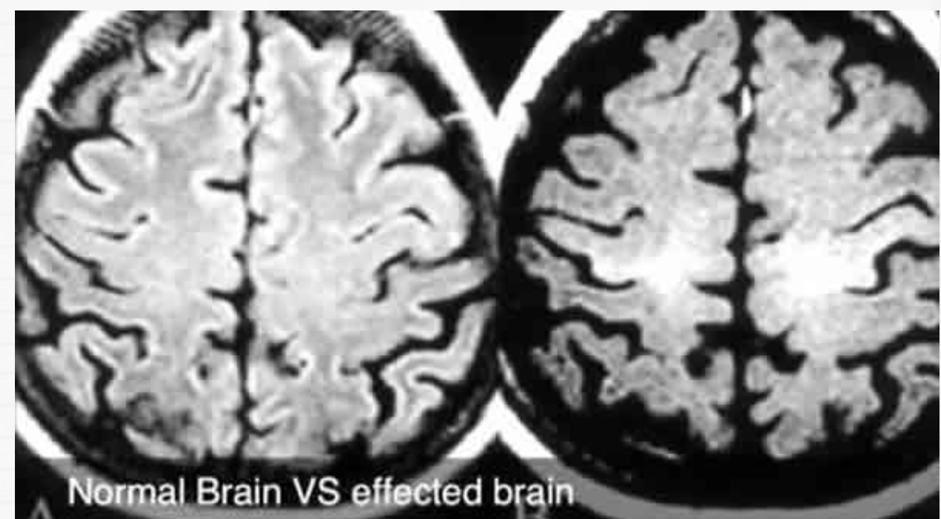
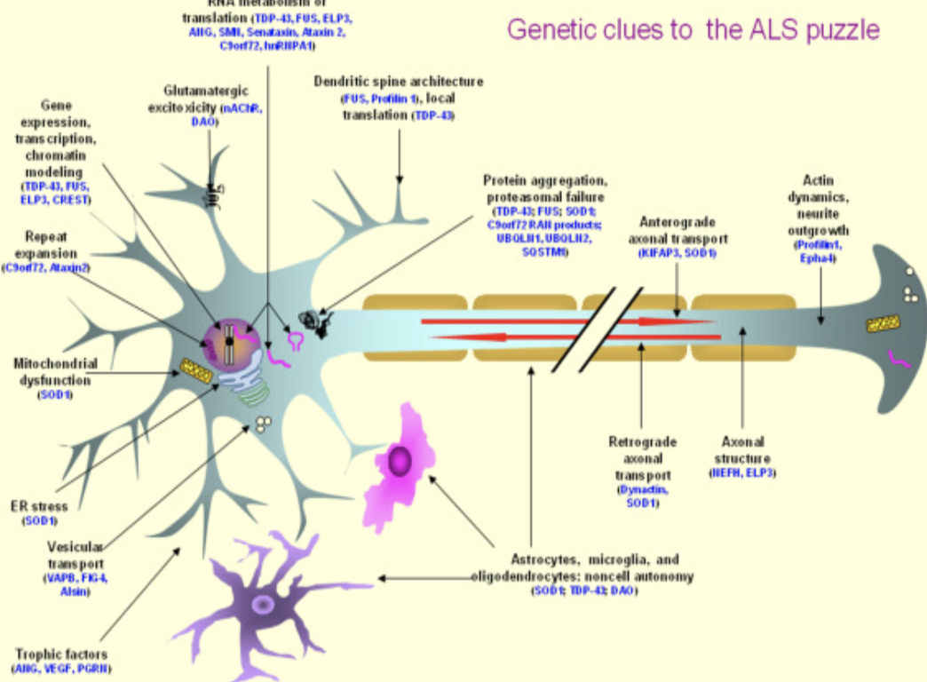

Slide 3

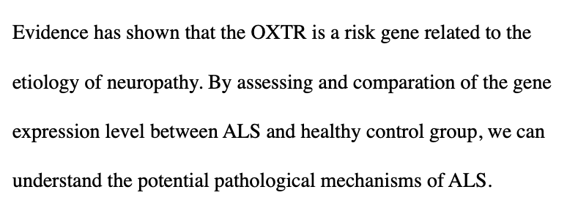

Slide 4
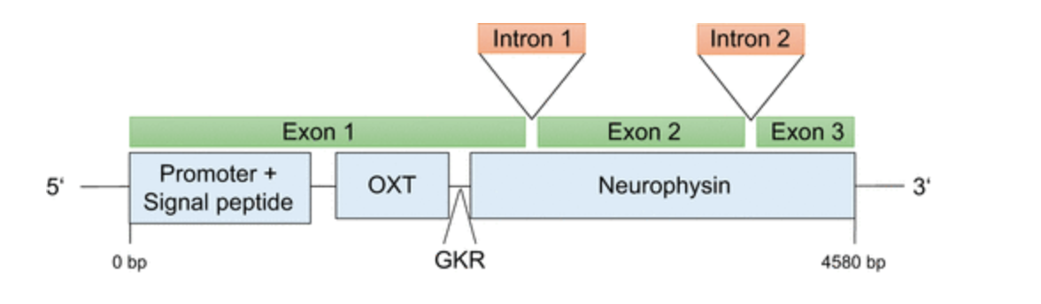
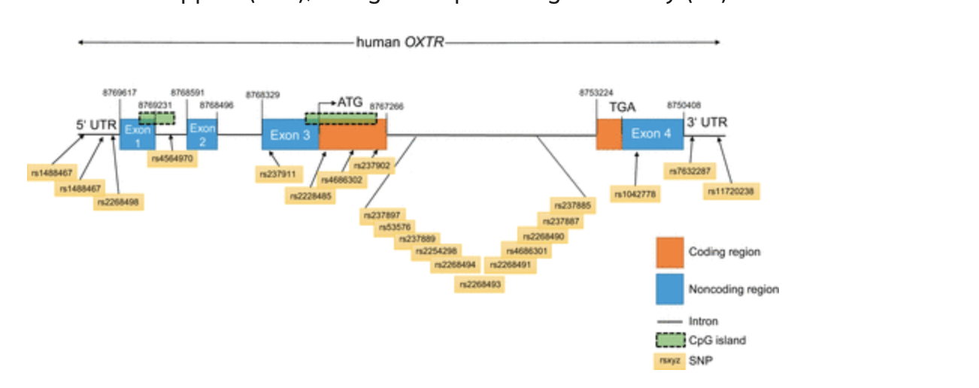

Slide 5
Sample
Subjects:
Original design contains 7 ALS and 8 healthy control people. We take two subjects from ALS and two subjects from healthy control group.
Procedures:
Postmortem cervical spinal section was used to extract total RNA.
•Individual Illumina Total Stranded RNA-sequencing libraries for each sample
•Each library was sequenced with >50 million 2X150 sequencing reads on the NextSeq500.
Paired end

Slide 6
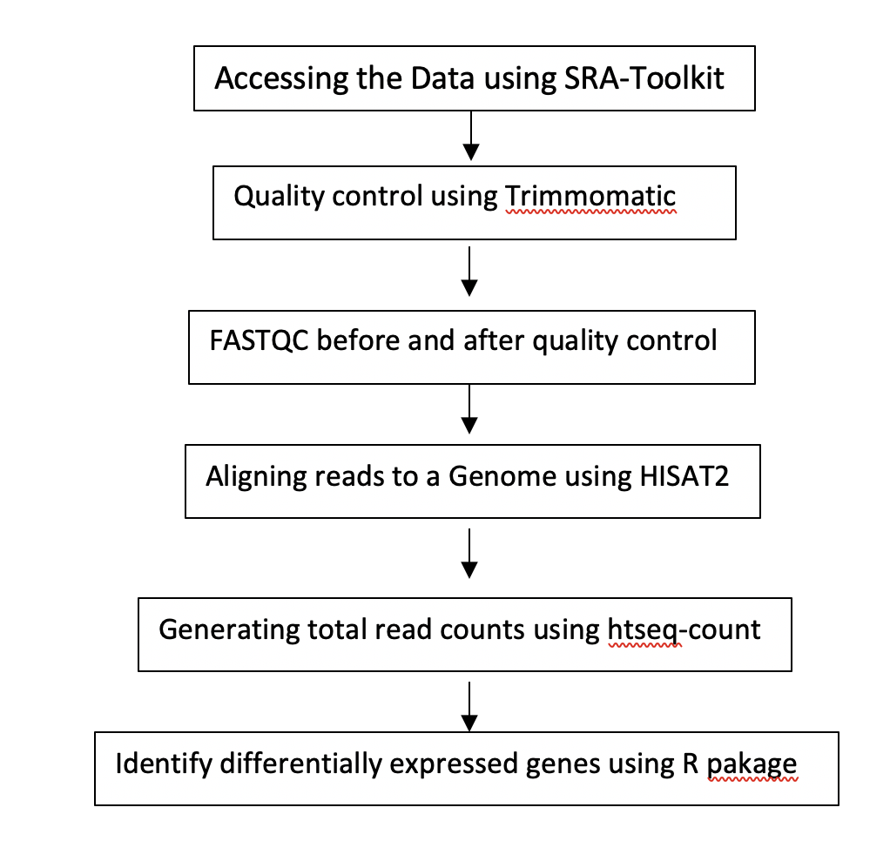
Flow chart of RNAseq analysis

Slide 7
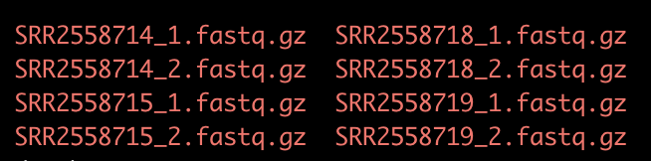
Accessing the data using SRA-Toolkit
We downloaded data from the NCBI. The SRA accessions are as follow:
ALS group: SRR2558714 & SRR2558715
Healthy control: SRR2558718 & SRR2558719
We download fastq files from SRA using sratoolkit 2.8.2.
We used the split_files, dump each read into separate files as our reads are paired-end.
Notes:
Split-files: separates the read into left and right ends, and puts the forward and reverse reads in two separate files. This creates two files.

Slide 8
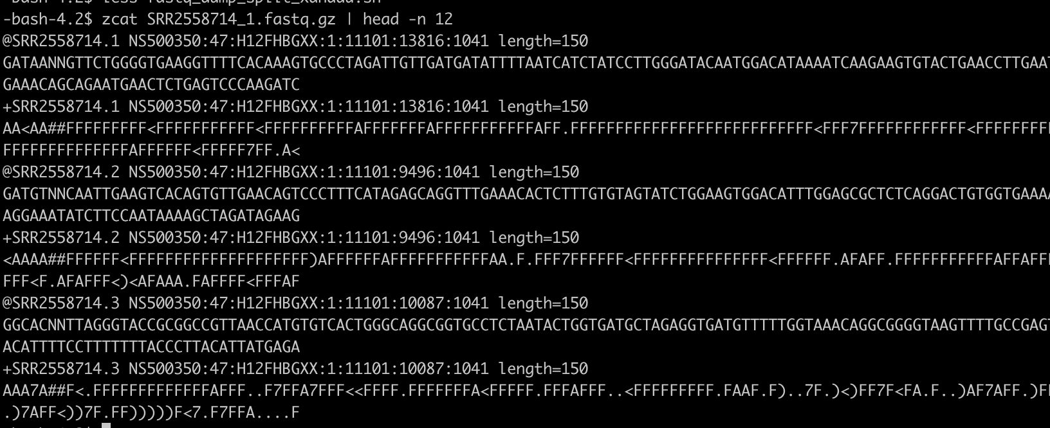
Accessing the data using SRA-Toolkit
The sequence files are in fastq format and compressed using gzip. We have a look at the contents of one of the fastq files:

Slide 9
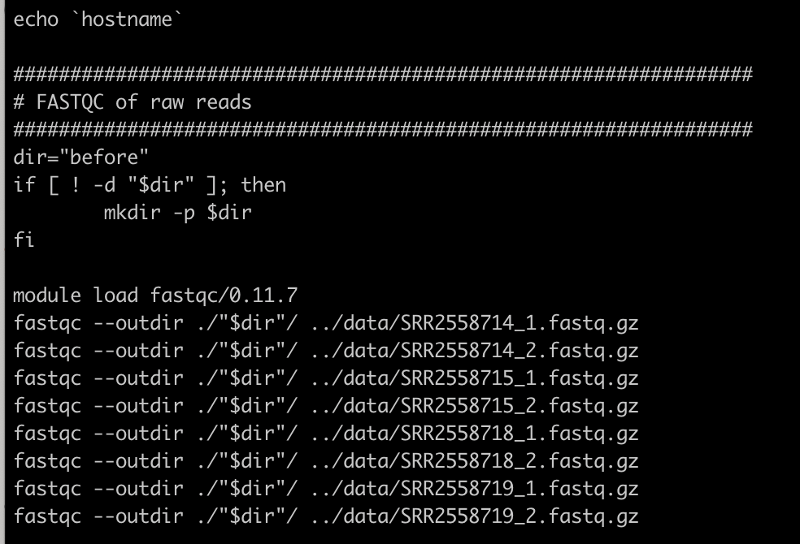
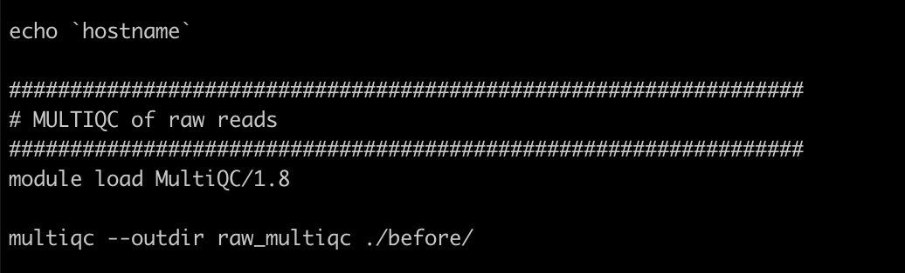
FASTQC
This step we perform a FASTQC which is helpful to see how the quality of the data has changed before and after trimming using Trimmomatic. To do this, we used the command-line of fastqc.
The fastq module load was version of 0.11.7

Slide 10
Quality Control Using Trimmomatic
We used Trimmomatic trim low-quality reads and adapter.
As our data is paired-end reads, we kept our fastq.gz separated in this procedure (SRR_1trim.fastq.gz & SRR_1un_trim.fastq.gz).
Instead of SE for single-end made, we used PE for paried-end mode based on the Trimmomatic manual.
ILLUMINACLIP: Truseq3-PE. Command searched for adapter sequence.
Slidingwindow: we used 4:15 scaned through the read, cutting the read when the average base quality in a 4 window frops below 15 which is matched with our quality scores.
Notes:
Keep both reads can be useful when working with paried-end data. It may keep even redunfant information but this likely makes our pipelines more manageable.

Slide 11
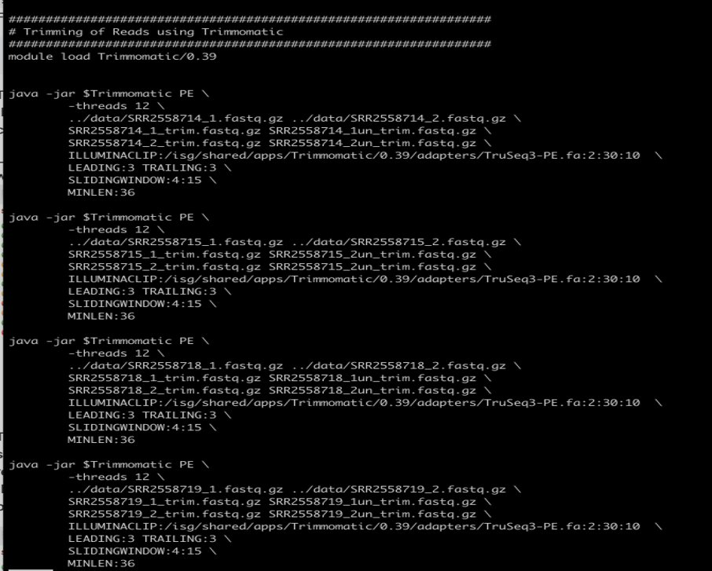

Slide 12
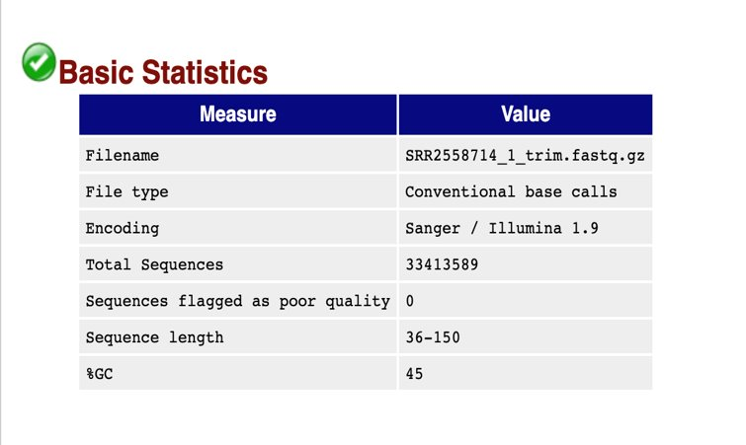
FASTQ before and after quality control
We used Cyberduck to view the ftml files. ​
FASTQ Report: take SRR2558714_1 as example:​

Slide 13
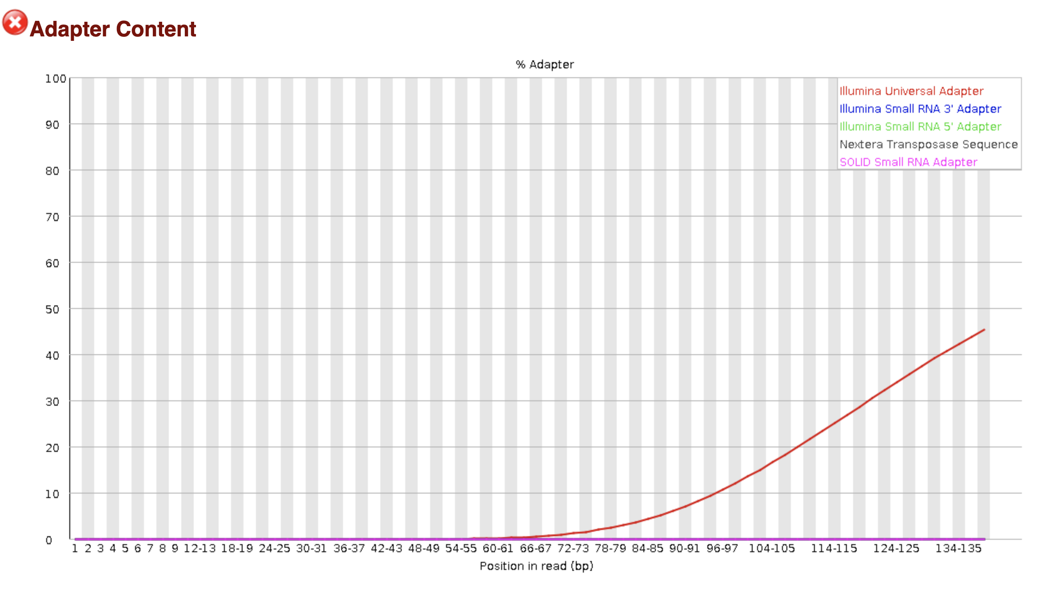
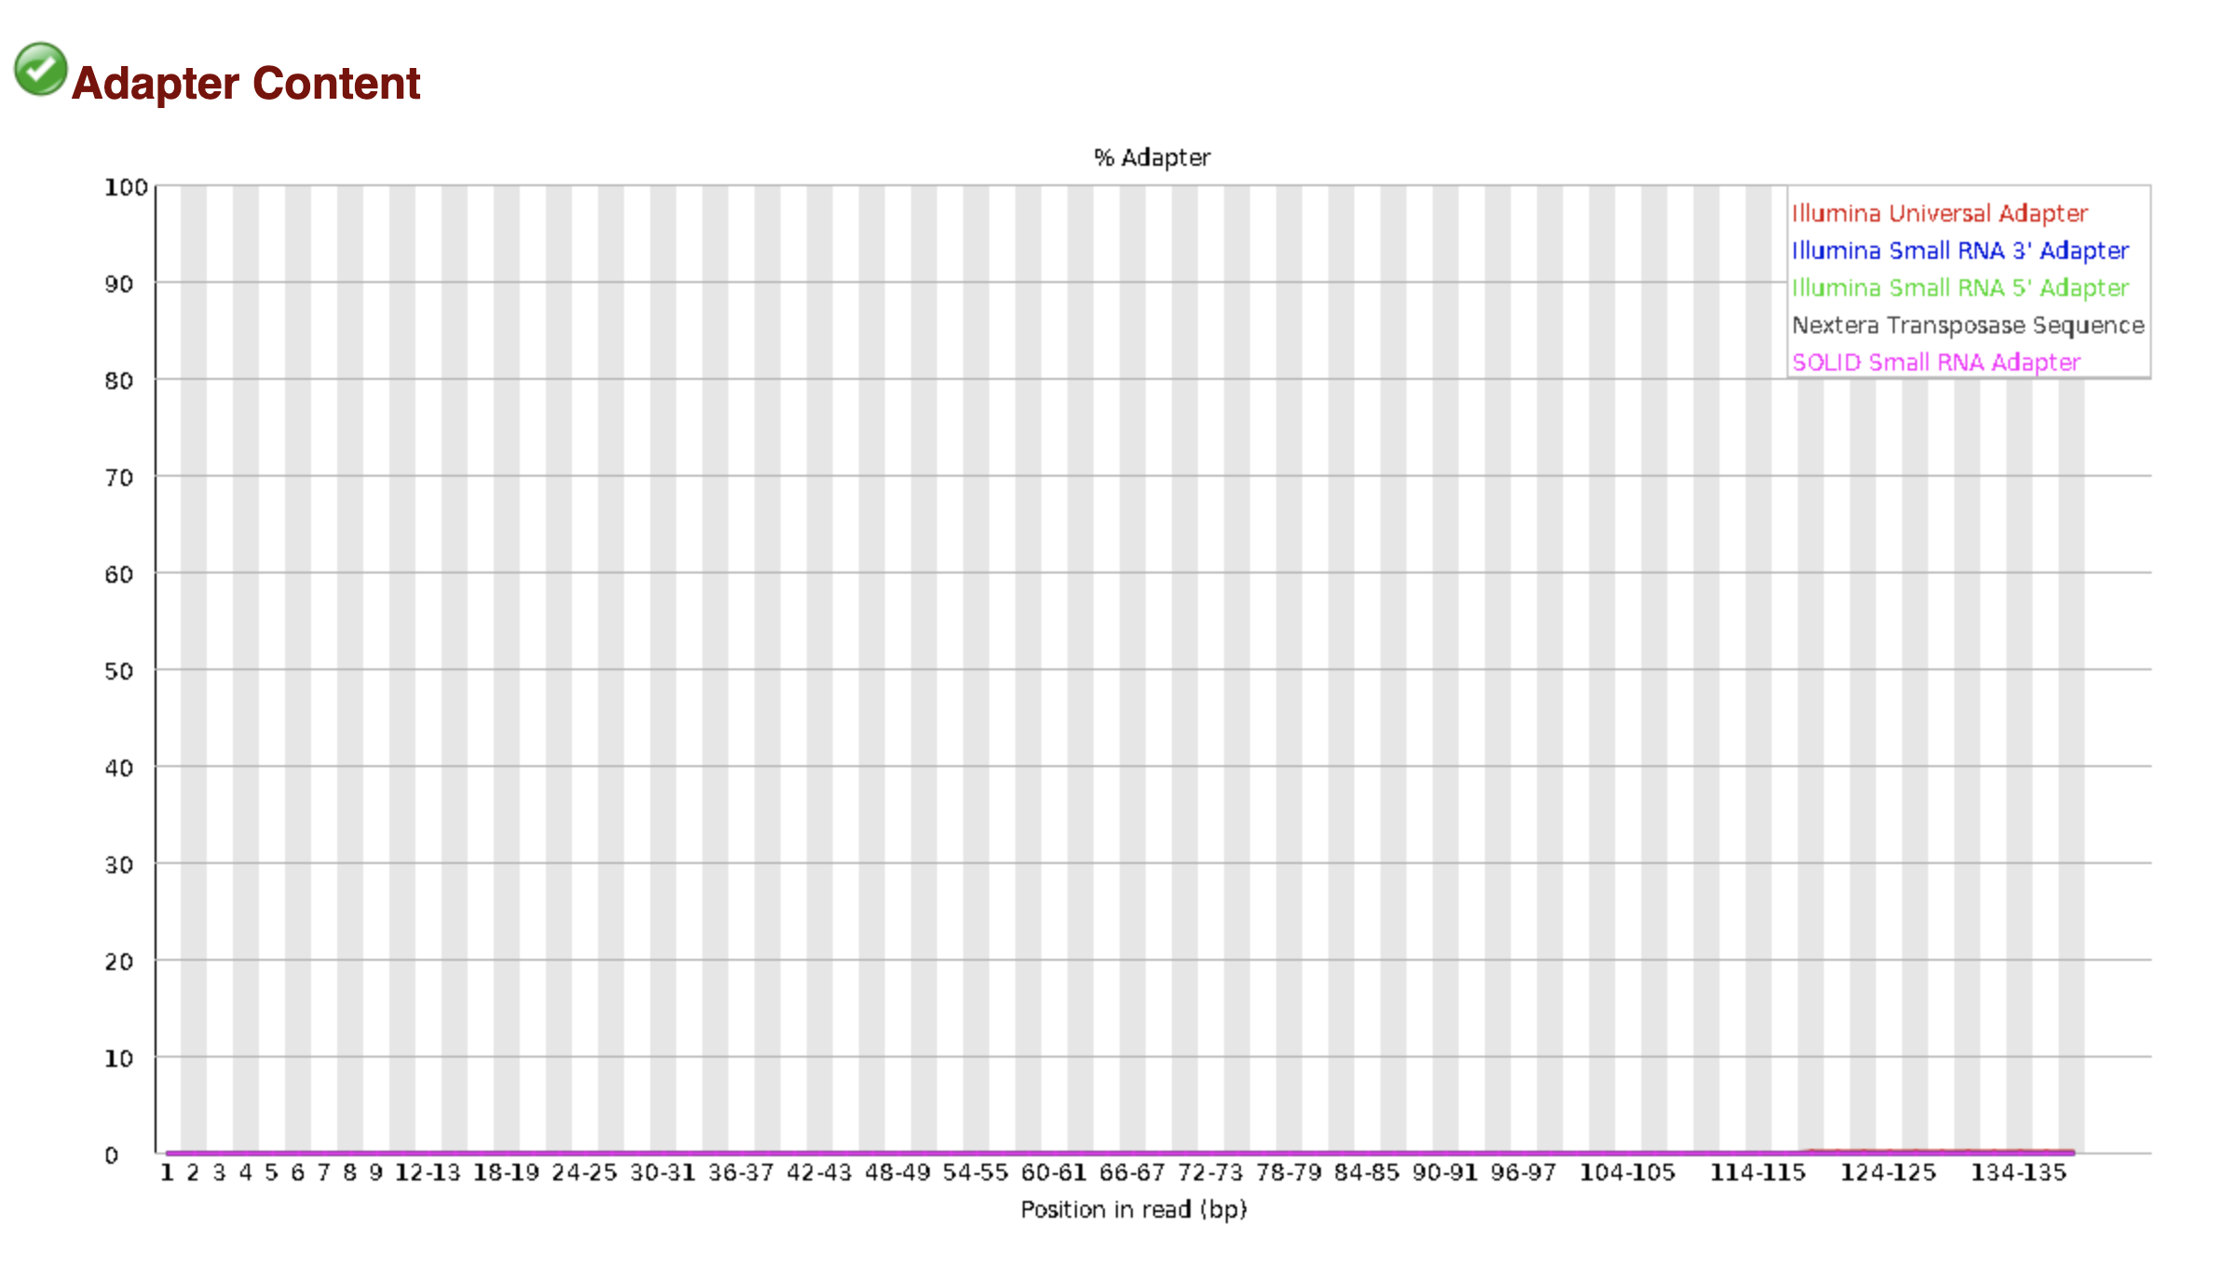
FASTQ before and after quality control

Slide 14
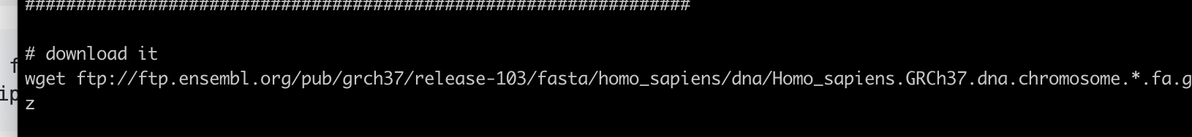
Aligning reads to a genome using HISAT2
We used HISAT2 mapping our data against the hg19 human genome
We used wget command download the hg19 from ENSEMBL database.

Slide 15
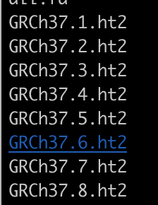
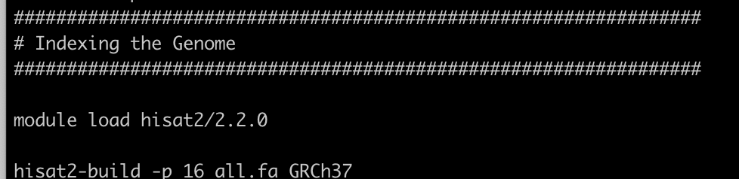
Aligning reads to a genome using HISAT2
Next, we created a genome index which is ordered in an easily navigable way with pointers to the information we seek within.
We used the hisat2-build module making a HISAT index file for the genome
Notes:
After running the scrpt, the following files will be generated as part of the index.

Slide 16
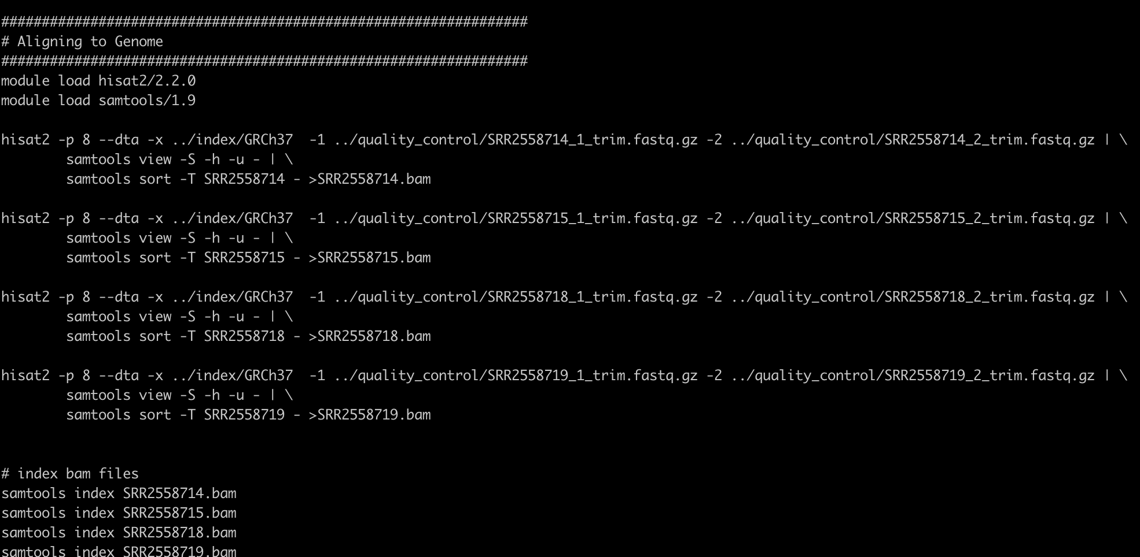
Aligning reads to a genome using HISAT2
We used pipe to send the results from HISAT2 to samtools to sort the sequences, convert them to binary format and compress them. The resulting files were in BAM format.

Slide 17
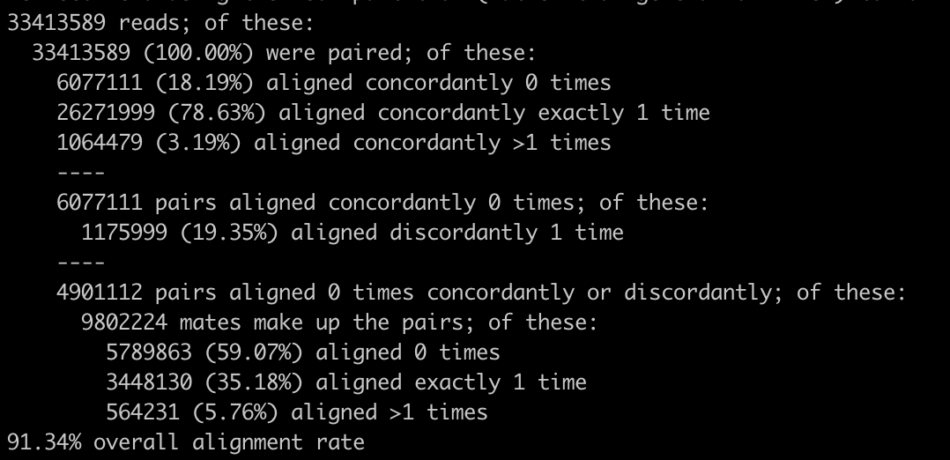
Aligning reads to a genome using HISAT2
An alignment summary for one single sample is shown below:
91.34% overall alignment rate

Slide 18
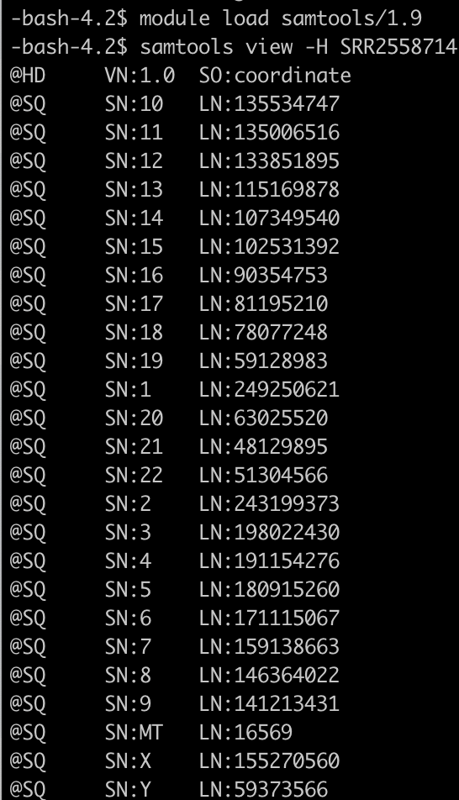
Aligning reads to a genome using HISAT2
Then we looked at the BAM files by sametools view –H SRR2558714.bam | head

Slide 19
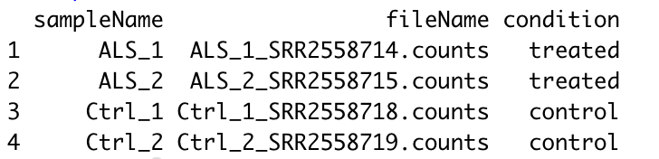
Pairwise Differential Expression with Counts in R
This step, we used R package DESeq2 to identify differentially expressed (DE) genes.
We used Cyberduck and downloaded the counts from xanadu.
Sample table:
Then we followed the tutorial to analyze our data

Slide 20
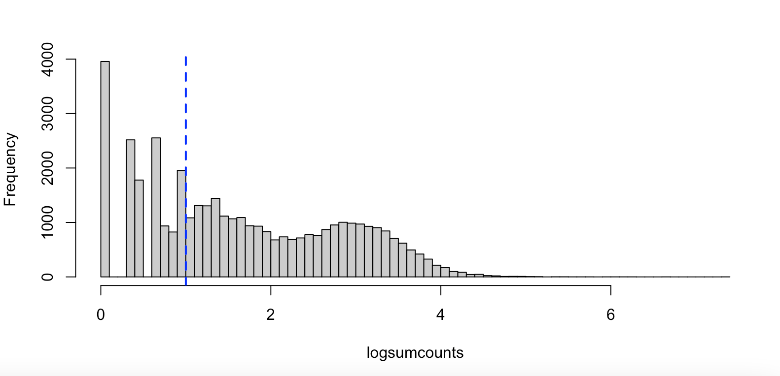
Histogram of the log scaled counts

Slide 21
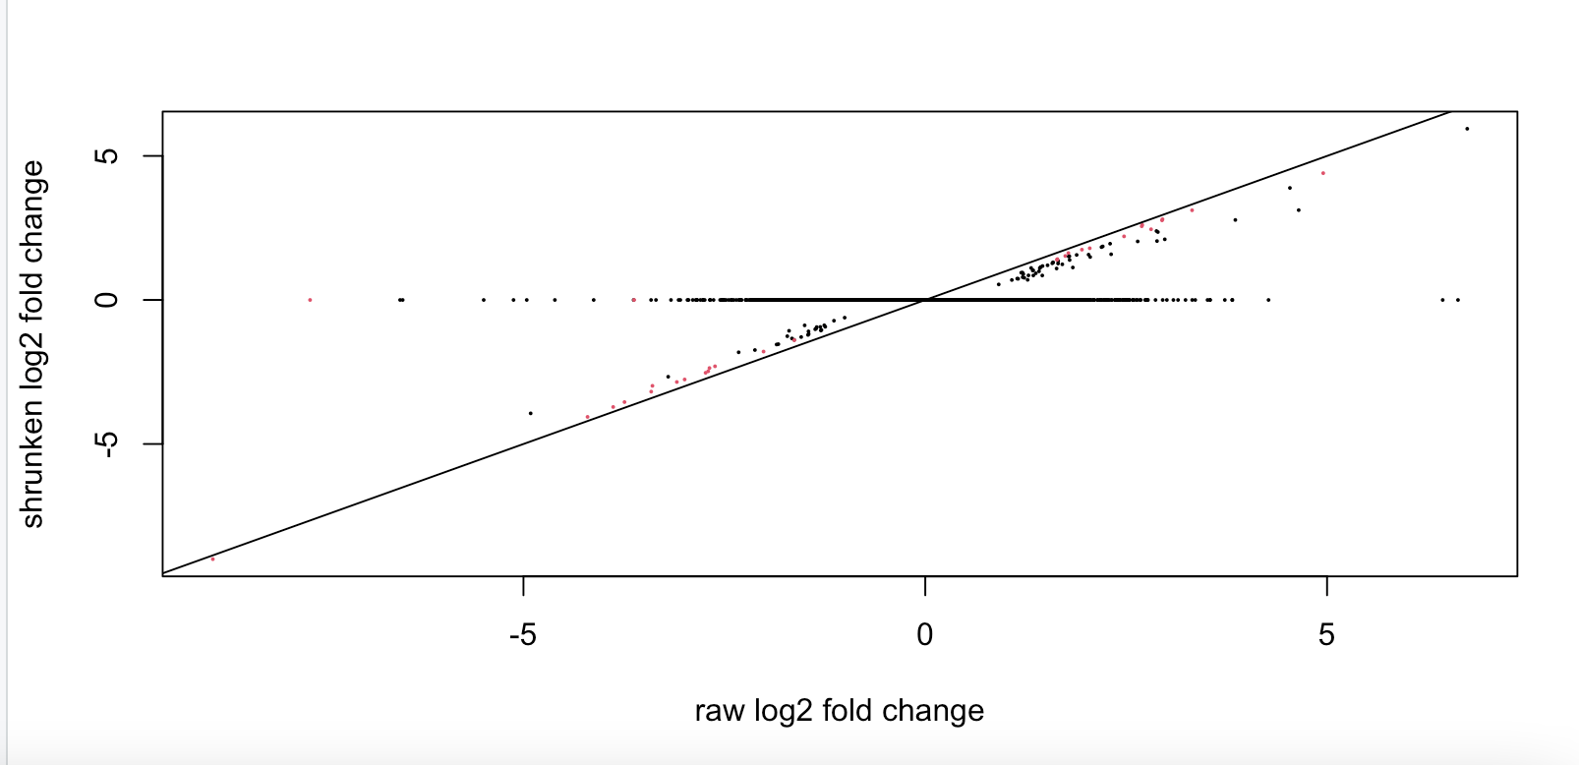
Plot the shrunken log2 fold changes against the raw changes:

Slide 22
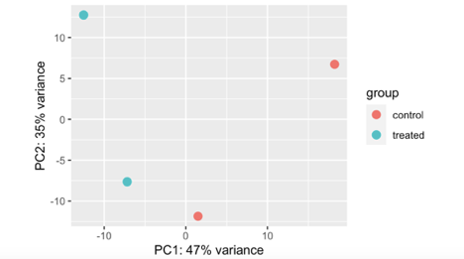
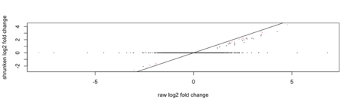
Normalized, variance-stabilized transformed counts for visualization

Slide 23
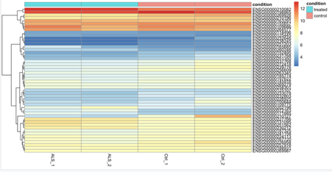
Top 50 log fold change genes

Slide 24
Next step
We found the count number of OXT and OXTR gene, we are going to...
 | ALS_1 | ALS_2 | Ctrl_1 | Ctrl_2
OXTR | 60 | 106 | 126 | 83
OXT | 460 | 221 | 328 | 471

